Slide 1

SUSTAINABILITY REPORT 2024

Slide 2
Sustainability encompasses all activities undertaken to meet today's needs while protecting our natural resources and leaving a more livable world for future generations. Sustainable development, on the other hand, involves establishing a balance between ourselves and the environment, protecting and preserving the resources of today and the future. To this end, we are working to contribute to the protection of our environment by meeting the requirements of Stage 3.

Slide 3
BUSINESS OPPORTUNITIES
OVERVIEW Address: No: 2, 2299th Street, Guzeloba Neighborhood Phone: 0536 606 79 97 Website: https://www.awenhotel.com/ E-Mail: Airport: 20 minutes Opening Hours: Number of Rooms: 40 Housekeeping: Yes Pets: -

Slide 4

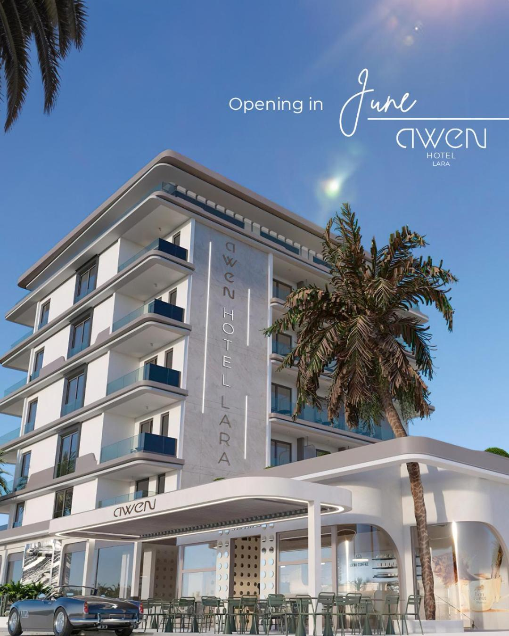
OUR DISTANCE TO LANDMARKS
Imperial 650 m
Antalya Sand Sculpture Museum 950 m
Duden Park 2 km
Yidirim Beyazit Mosque 1.4 km
Güzeloba Friday Market 1.3 km
Lara Beach Park 750 m
Sandland 950 m
Düden Waterfall 1.9 km
Celilov Imperial 1.5 km
Antalya Airport 13 km
C

Slide 5
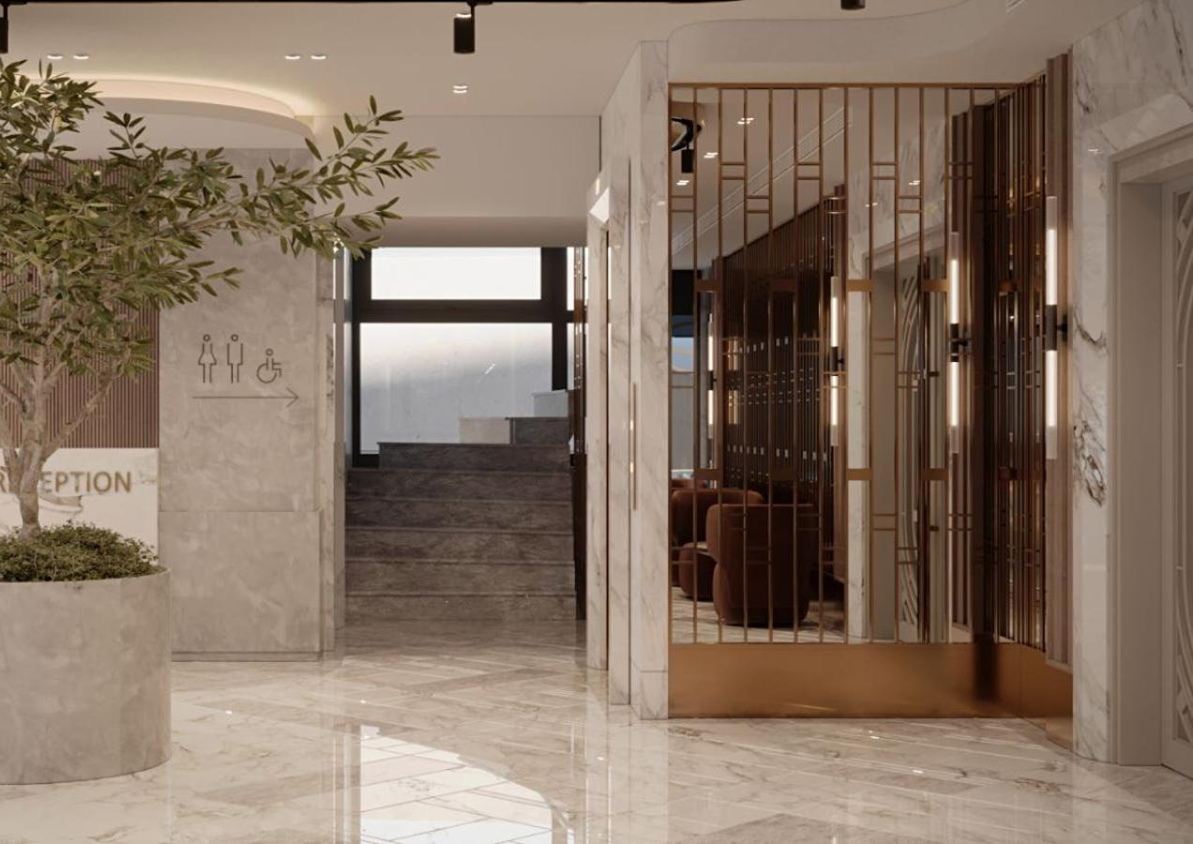
HOTEL ACCESSIBILITY
Accessible features
Elevator
Public area accessible restroom

Slide 6
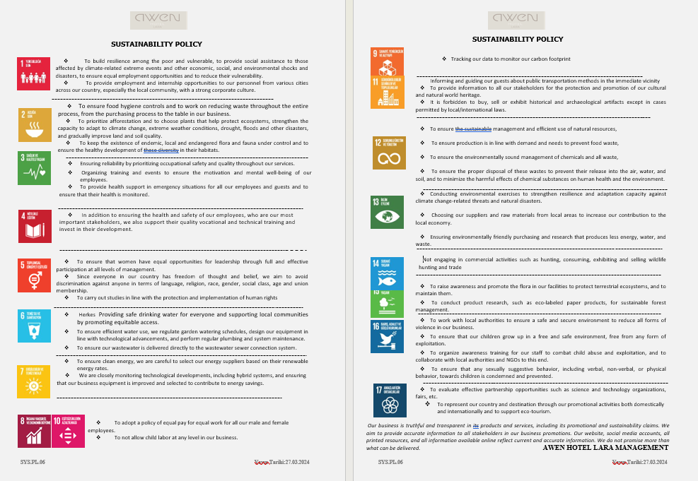
SUSTAINABLE TOURISM POLICY

Slide 7

WE SEPARATE WASTE FOR RECYCLING.

Slide 8
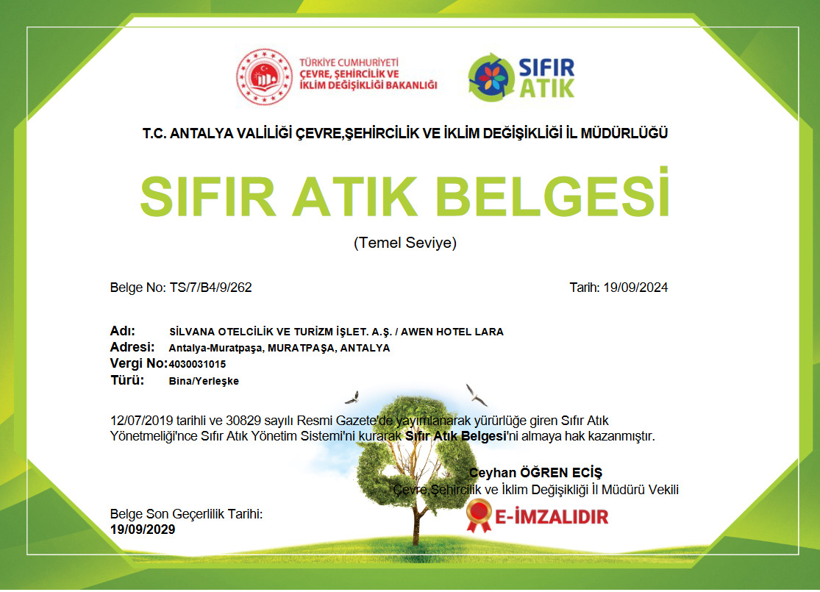
WE SEPARATIVE WASTE FOR RECYCLING.
WE HAVE A ZERO WASTE CERTIFICATE.

Slide 9
All waste generated from our business is separated in accordance with zero waste and all our waste is recorded.

Slide 10
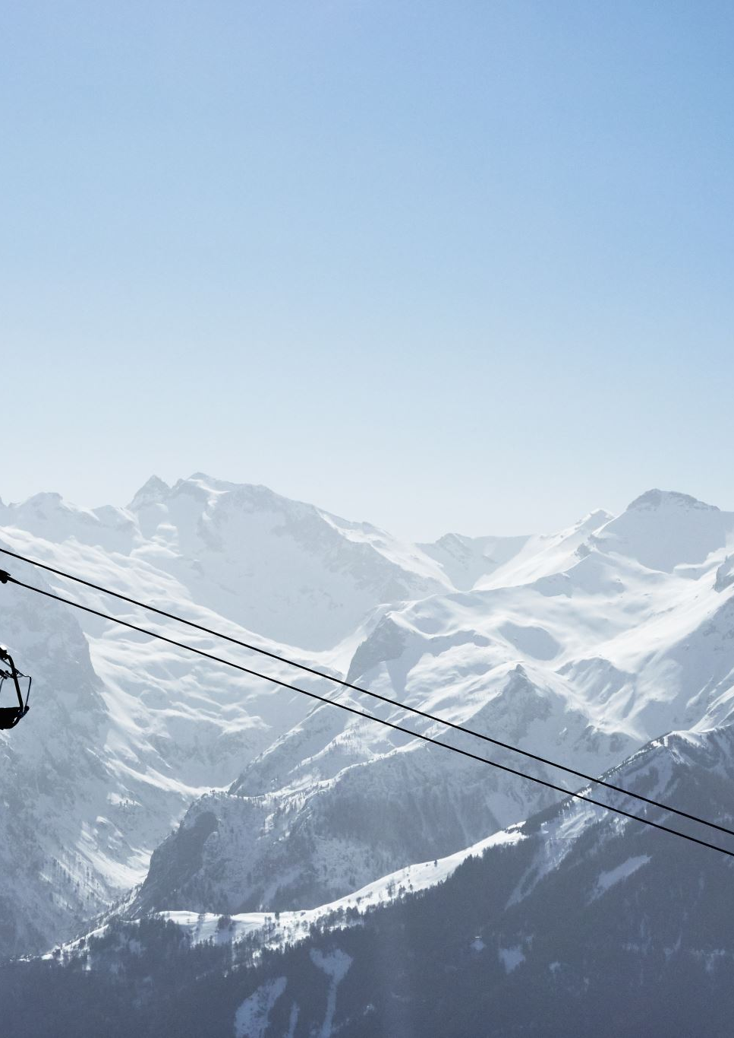
2024
ELECTRICAL DATA
Electricity consumption is constantly monitored and recorded in the electricity consumption tracking table by our sustainable tourism team.

Slide 11
2024
ELECTRICAL DATA

Slide 12
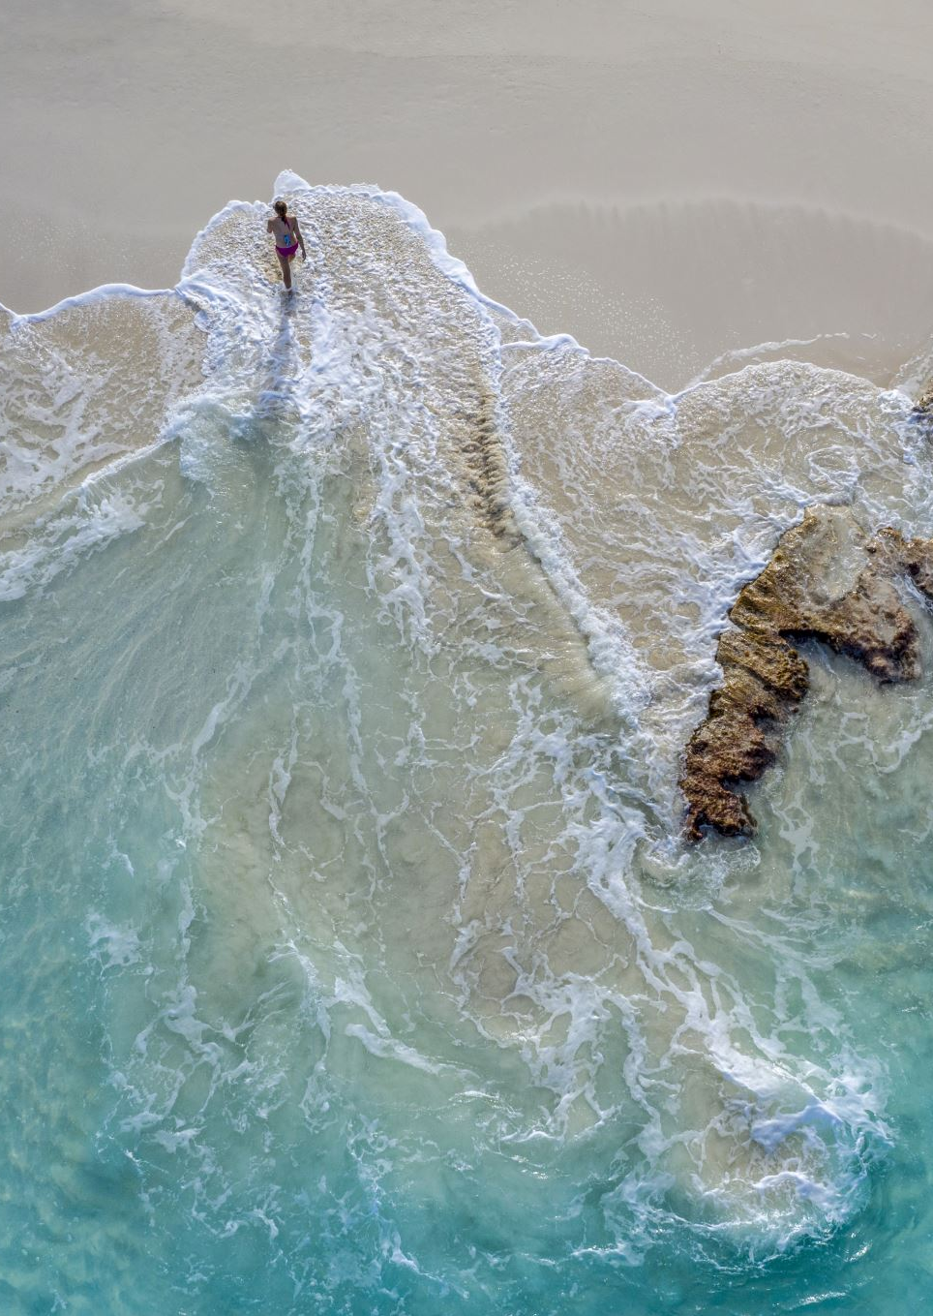
2024
WATER CONSUMPTION DATA
Water consumption is constantly monitored and recorded in the water consumption tracking table by our sustainable tourism team.

Slide 13
2024
WATER CONSUMPTION DATA

Slide 14

2024 CHEMICAL CONSUMPTION
We ensure that our personnel receive ongoing training on the quantities and methods of chemicals used in our facility.
We prioritize environmentally friendly chemicals used in our facility, and we utilize dosing units to ensure adequate amounts are used to avoid excessive chemical consumption.

Slide 15
2024 ENVIRONMENT AND WASTE MANAGEMENT
At our facility, waste is separated according to a zero-waste system. Separated packaging waste, hazardous waste such as fluorescent tubes, toner, organic waste, medical waste, waste vegetable oils, and batteries are collected separately. These wastes are stored in temporary storage areas designated in accordance with regulations within the facility. They are then collected by licensed and authorized companies with whom we have agreements.
After waste is sent to the relevant separation and recycling facilities, the delivery dates and quantities are recorded in an Excel file, and the amounts sent are also entered into the ECBS information system.

Slide 16

In accordance with our SUSTAINABLE PURCHASING policy, we prioritize selecting local suppliers and raw materials, prioritize fair trade, and prioritize ensuring our business partners and purchasing operations are conducted sustainably.
In this context, we invite our suppliers and business partners to understand and support our sustainability policy.
As a business, we implement sustainability practices in tourism, driven by our commitment to living in balance and harmony with the environment. We aim to minimize the negative impacts of tourism on both our society and our environment. Through our adopted policies, we aim to contribute to the local economy, the preservation of natural and cultural heritage, and the improvement of the quality of life of our local residents and guests. In this context, we would like to inform you that we implement sustainability policies that embrace continuous development and transformation. While adapting to the technological world we live in, we must also prioritize sustainability and prioritize our cultural heritage, ensuring we all contribute to an environmentally friendly life for a more livable planet. Because the concept of sustainability essentially implies awareness; it should be a societal goal, not an individual one. Therefore, we ask you to contribute to this awareness.

Slide 17
78% of the suppliers we work with are local.
Our goal is to increase this ratio next year.

Slide 18

THE MOST IMPORTANT SUSTAINABILITY LINK IN OUR BUSINESS IS OUR EMPLOYEES.

Slide 19
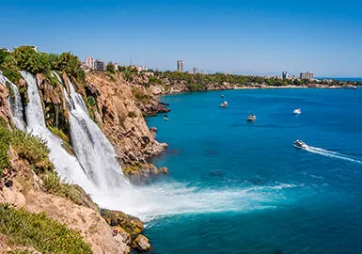
Experiencing cultural heritage in our facility..

Slide 20

INTRODUCTION OF CULTURAL AREAS
Kaleiçi Old Antalya Houses
Fluted Minaret Şehzade Korkut Mosque
Karatay Madrasa
Perge Ancient City Karain Cave Hadrian's Gate Phaselis Ancient City, Phaselis Aspendos Theater
Xanthos Ancient City
Alanya Castle Myra Ancient City Temple of Apollo Olympos Ancient City

Slide 21

REMINDERS ABOUT BEHAVIORAL ISSUES THAT NEED TO BE IMPLEMENTED TO DEVELOP SUSTAINABILITY IN TOURISM:
CODE OF CONDUCT
We are aware that the relationship between our cultural heritage and natural resources, and between society and the environment, is crucial for ensuring their long-term sustainability for future generations. Therefore, we would like to remind you of these important details.
Speaking loudly and using slang should be avoided in Cultural Sites.
We should not damage the artifacts and resources in Cultural Sites.
We should avoid behavior that disturbs others when visiting sensitive areas.
We should keep Natural Areas clean and avoid littering.
To maintain the balance and continuity of natural life, we should avoid activities that harm living creatures.
We should protect trees and plants and warn those who damage green spaces.
We should not engage in activities that harm natural environments, including animals.
When visiting religious sites, we should wear clean clothing, avoid loud speech, and avoid disturbing other people.

Slide 22
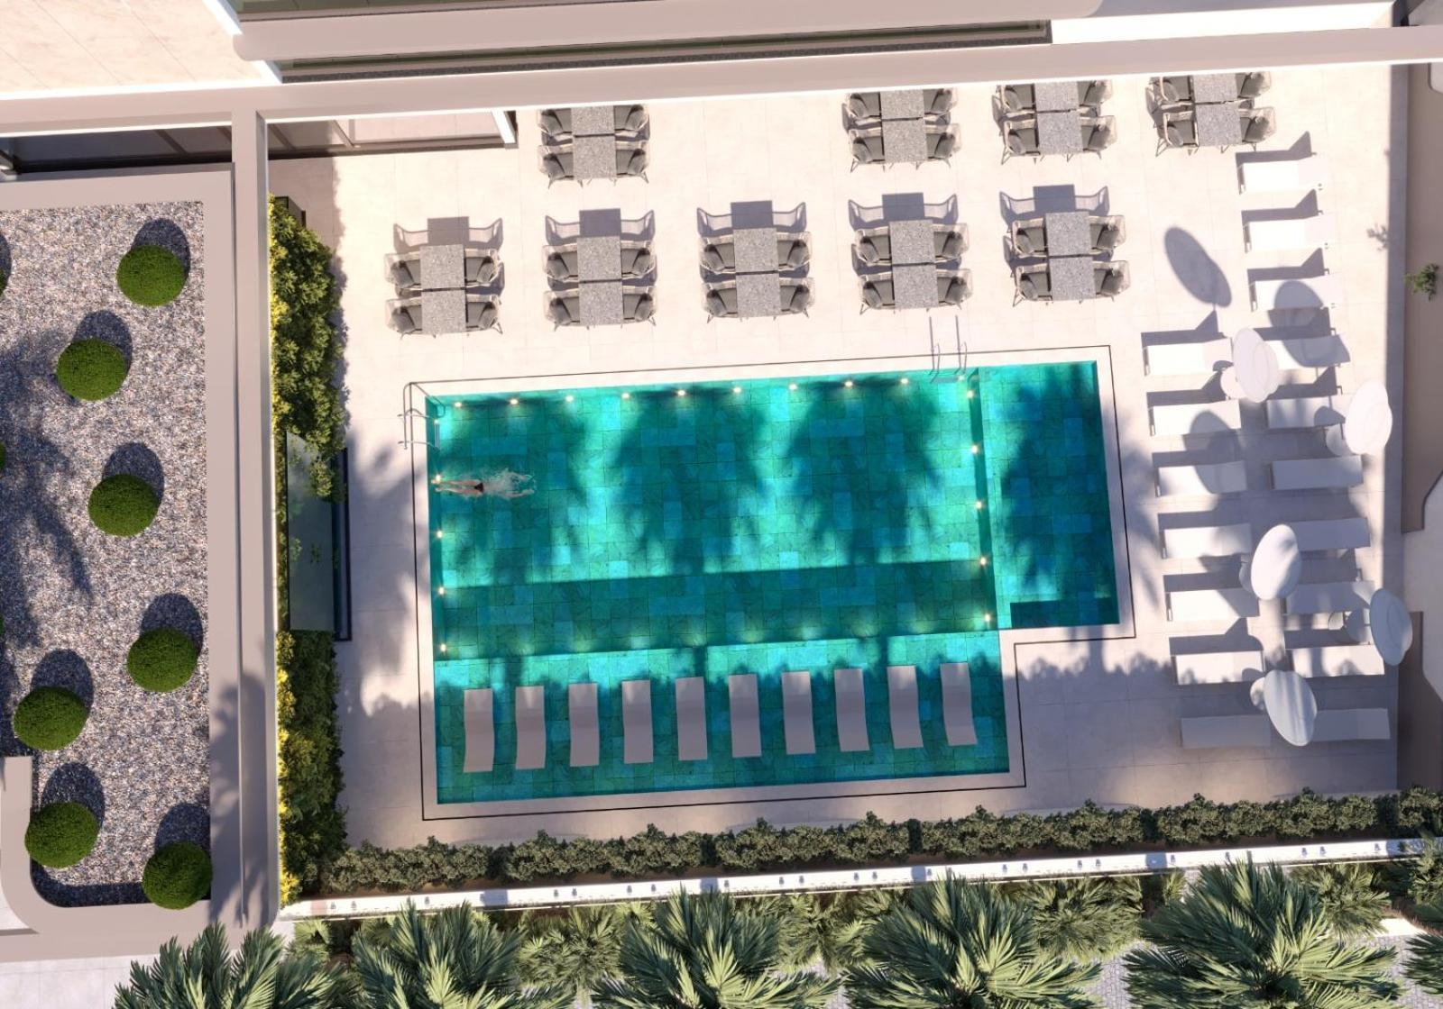
WE USE PLANTS THAT ARE ADAPTABLE TO THE REGIONAL CLIMATE IN OUR LANDSCAPES. THUS, WE ALSO CONTRIBUTE TO WATER SAVINGS.

Slide 23



SOCIAL SUPPORT OF OUR BUSINESS

Slide 24
THANK YOU FOR SUPPORTING US WHILE CONTRIBUTING TO THE DEVELOPMENT OF SUSTAINABLE TOURISM.

